Slide 1
Selenium IDE
David Corcoran

Slide 2
Contents
Automated Testing
Overview of Selenium
Pros & Cons
Comparative Analysis of Alternatives
Summary
Live Demo

Slide 3





What Is Automated Testing?
The practice of automating a process to verify whether a program meets predefined requirements through expected and unexpected test case scenarios.

Slide 4
Requirements Analysts
Identify system requirements
Describe user expectations
Write test cases
Utilize an automated testing software
Compare results to predetermined expectations

Slide 5
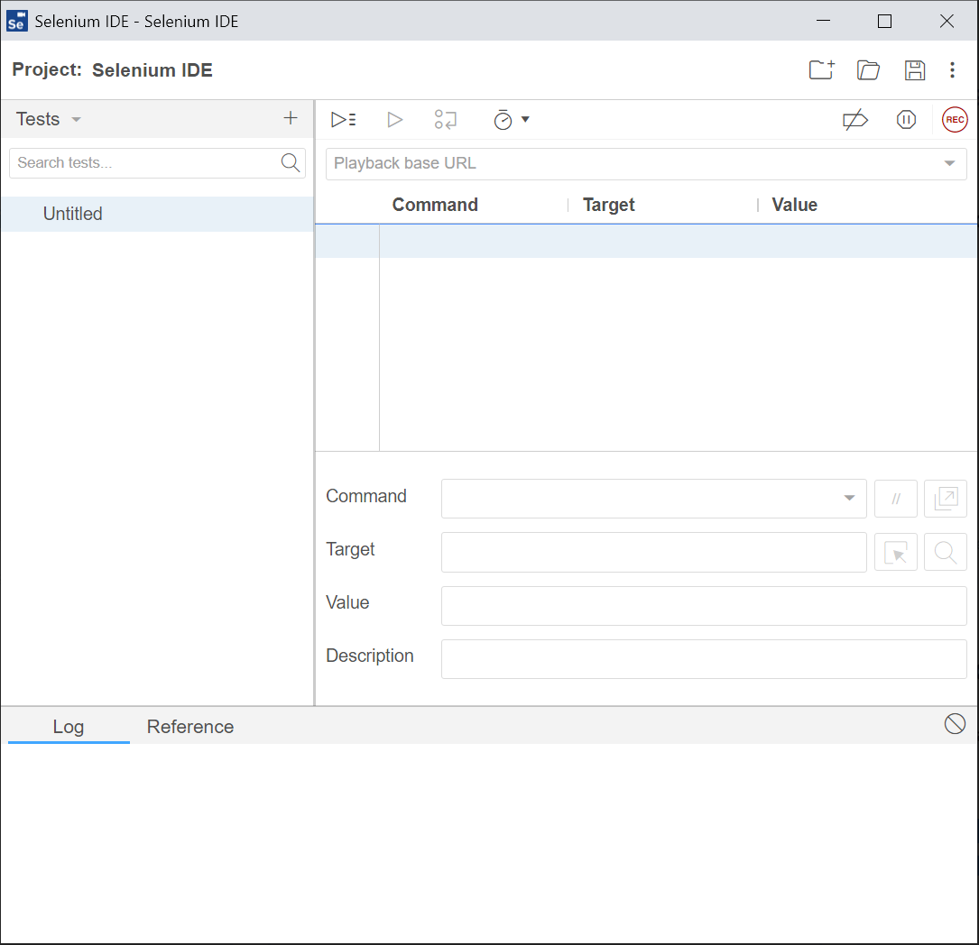
Overview of Selenium IDE
“Integrated Development Environment”
Previously known as Selenium Recorder
Created by Shinya Kasatani in 2006
Actively Maintained since 2018
Record interactions with websites
Editing and playback of tests scripts

Slide 6

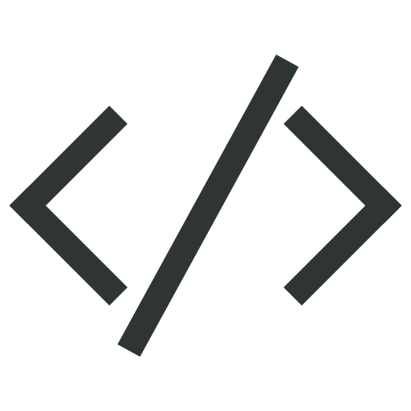

Who Uses Selenium IDE?
Requirements Analysts
Developers
Quality Assurance Teams

Slide 7

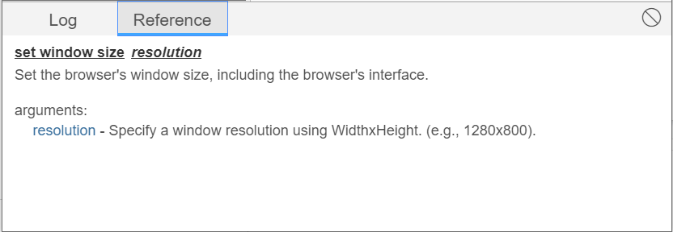
Important Features
Record/Playback
Testing suites/Parallel testing
Breakpoints
“Target” functions
Testing log
Command reference

Slide 8

Selenium IDE Pros and Cons
Advantages
Small learning curve - simple
No programming knowledge required
Code export
Official and non-official plug-ins
Updatable scripts
Simple installation
Disadvantages
Limited to Chrome and Firefox
No mobile applications testing
Difficult to test dynamic web applications

Slide 9
Alternatives to Selenium IDE
Zephyr
Selenium Webdriver
Katalon Studio
Pingdom

Slide 10
Selenium IDE vs Zephyr
 |  |  | Winner
Ease of Use | Simple layout No-code environment Browser extension | Simple Layout Sync requirements and tests from Jira | Selenium IDE
Functionality | Record/Playback “Selenese” commands Parallel Testing | Import automated tests and export results Sprint scheduling | Selenium IDE
Price | Free | $10/Month 30-Day Trial | Selenium IDE

Slide 11
Selenium IDE vs Selenium WebDriver
 |  |  | Winner
Ease of Use | Simple layout No-code environment Browser extension | Steep Learning curve Programming knowledge required | Selenium IDE
Functionality | Record/Playback “Selenese” commands Parallel Testing | Multiple language support Handling of dynamic web elements Cross-device testing | Selenium WebDriver
Price | Free | Free | Tie

Slide 12
Selenium IDE vs Katalon Studio
 |  |  | Winner
Ease of Use | Simple layout No-code environment Browser extension | Simple Layout No-code environment Dashboard view | Tie
Functionality | Record/Playback “Selenese” commands Parallel Testing | Record/Playback Supports Java & groovy Manual test writing | Katalon Studio
Price | Free | Free | Tie

Slide 13
Selenium IDE vs Pingdom
 |  |  | Winner
Ease of Use | Simple layout No-code environment Browser extension | Simple layout No-code environment | Tie
Functionality | Record/Playback “Selenese” commands Parallel Testing | Website insights Root cause analysis Repeated testing | Pingdom
Price | Free | $10/Month 30-Day Trial | Selenium IDE

Slide 14
Full Comparison
 |  |  |  |  |  | Winner
Ease of Use | - Simple layout - No-code environment - Browser extension | - Simple Layout - Sync requirements and tests from Jira | - Steep Learning curve - Programming knowledge required | - Simple Layout - No-code environment - Dashboard view | - Simple layout - No-code environment | Selenium IDE & Katalon
Functionality | - Record/Playback - “Selenese” commands - Parallel Testing | - Import automated tests and export results - Sprint scheduling | - Multiple language support - Handling of dynamic web elements - Cross-device testing | - Record/Playback - Supports Java & groovy - Manual test writing | - Website insights - Root cause analysis - Repeated testing | Selenium Webdriver
Price | Free | $10/Month 30-Day Trial | Free | Free | $10/Month 30-Day Trial | Selenium & Katalon

Slide 15
Comparison Conclusions
Ease of Use
Selenium IDE and Katalon Studio are the easiest to learn and use
Almost identical graphical layouts
Selenium Webdriver difficult to learn
Features
Selenium WebDriver is by far the best platform in terms of function
Multiple language support, cross-device testing, and testing of dynamic web elements
Price
Selenium IDE, Katalon Studio and Selenium WebDriver are both completely free
Other programs have free and paid versions

Slide 16
Project Applications
Sprint 1 - Peer Eval
Complete Student Evaluation
Invalid Student Login
Valid Student Login
Sprint 2 - Scheduling
Schedule Peer Evaluation
Invalid Instructor Login
Valid Instructor Login
Sprint 3 - Edit Groups
Edit Student Groups
Import Students and Courses

Slide 17
Summary
Selenium IDE is:
Free
Easy to lean
Programming-free
Helpful for beginners
Easy to navigate

Slide 18
Helpful Links
Selenium IDE Tutorial For Beginners
Selenium IDE Commands
Selenium IDE Commands With Examples

Slide 19
References
https://www.altexsoft.com/blog/engineering/the-good-and-the-bad-of-selenium-test-automation-tool/#:~:text=With%20a%20list%20of%20several,different%20testing%20problems%20and%20needs.
https://www.browserstack.com/guide/what-is-selenium-ide#:~:text=Selenium%20IDE%20(Integrated%20Development%20Environment,cases%20for%20their%20web%20applications.
https://www.selenium.dev/selenium-ide/docs/en/introduction/getting-started
https://www.altexsoft.com/blog/engineering/the-good-and-the-bad-of-katalon-studio-automation-testing-tool/#:~:text=Katalon%20vs%20Selenium,-Comparison%20of%20Selenium&text=Katalon%20is%20younger%2C%20has%20a,the%20most%20popular%20programming%20languages.
https://u-tor.com/topic/qa-roles-and-responsibilities
https://d1xu91qo2vrtxn.cloudfront.net/

